Slide 1
Capstone Engagement
Assessment, Analysis, and Hardening of a Vulnerable System
Prepared By: Tamantha Boychuk, April 25, 2022
Tamantha Boychuk April 2022

Slide 2
Table of Contents
This document contains the following sections:
01
Network Topology
02
Red Team: Security Assessment
03
Blue Team: Log Analysis and Attack Characterization
04
Hardening: Proposed Alarms and Mitigation Strategies
Hardening: Proposed Alarms and Mitigation Strategies
Tamantha Boychuk April 2022

Slide 3
Network Topology
‹#›

Slide 4
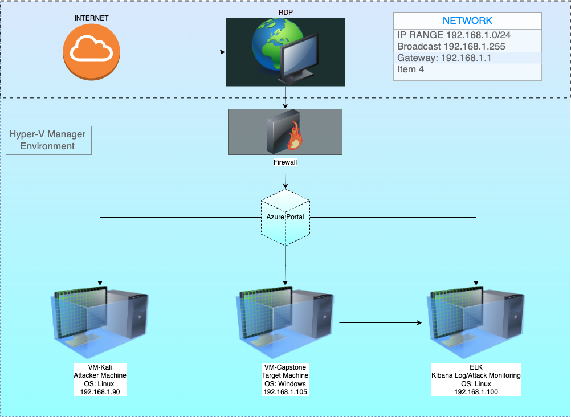
Network Topology
Network
Range:192.168.1.0/24
Broadcast: 192.168.1.255
Gateway: 192.168.1.1
Machines
Attacker 192.168.1.90
OS:Linux
Hostname:Kali
Target 192.168.1.105
OS:Linux
Hostname:Capstone
RDP 192.168.1.1
OS: MAC OS
Hostname:Remote Desktop
Kibana 192.168.1.100
OS:Linux
Hostname:ELK
Tamantha Boychuk April 2022

Slide 5

Red Team
Security Assessment
Tamantha Boychuk April 2022
‹#›

Slide 6
Recon: Describing the Target
Nmap identified the following hosts on the network:
Hostname | IP Address | Role on Network
Kali | Source.ip 192.168.1.90 | Kali was used as the attack machine.
Capstone | Destination.ip 192.168.1.105 | Capstone was the target machine.
ELK | 192.168.1.100 | ELK machine used to collect, process and send data to be analyzed later in Kibana.
Hyper-V-Manager | 192.168.1.1 | Is the jump box for Kali, Capstone and ELK.
Tamantha Boychuk April 2022

Slide 7
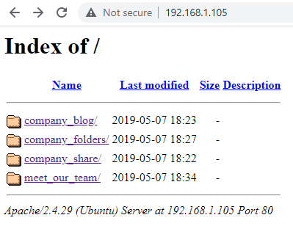
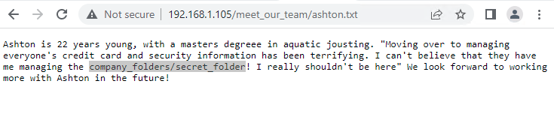
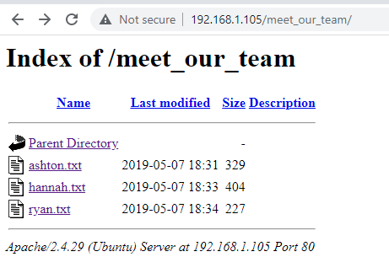
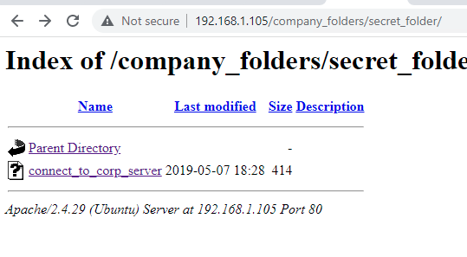
IP Address Exploration Results
Tamantha Boychuk April 2022

Slide 8
Exploitation: Hydra Brute Force Attack
01
02
03
Tools & Processes
Used Hydra to perform a dictionary attack to retrieve credentials of existing users to include usernames and passwords.
Ashton was being targeted specifically for his access to the companies “secret folder.”
Achievements
The brute force attack was successful in retrieving and matching password to Ashton. Gained access to secret_folder which led to another folder named connect_to_corp_server where a note regarding how to access the companies WebDAV server was found.
Exploit Command:
Hydra -l ashton -P /usr/share/wordlists/rockyou.txt -s 80 -vV 192.168.1.105 http-get /company_folders/secret_folder
-l = single user name
-P= list of passwords
-s= Port number
=vV= Verbose/show login+pw combination for each attempt
Tamantha Boychuk April 2022 Clickable Hyperlinks Highlighted & Underlined In Blue

Slide 9
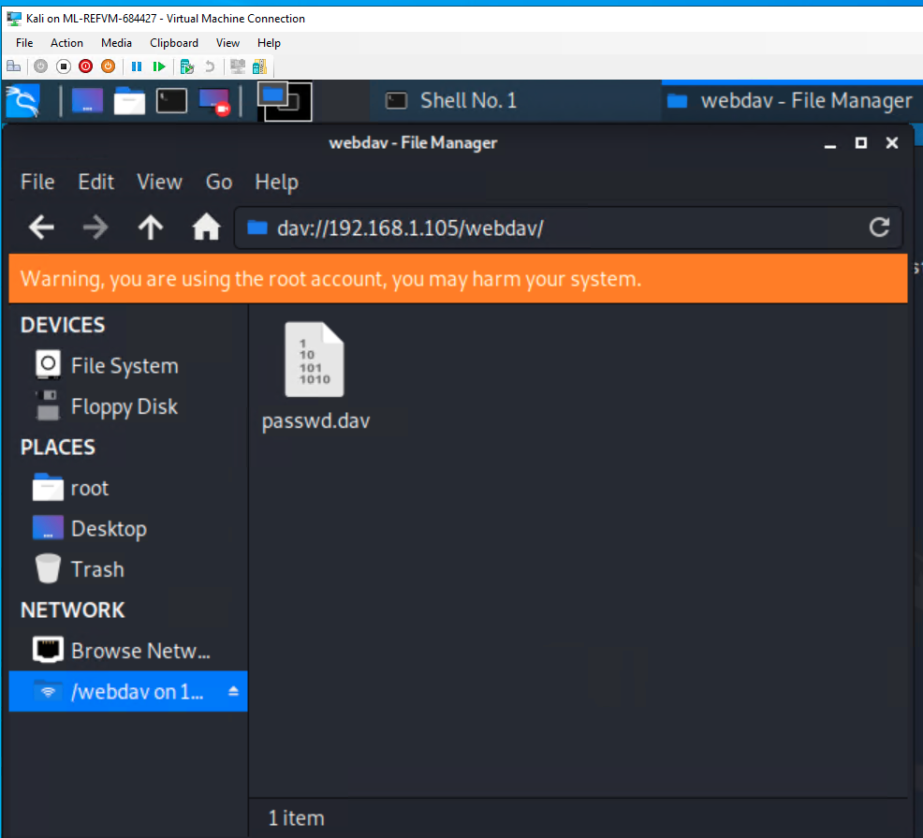
Exploitation: WebDAV Connection Exploit
01
02
03
Tools & Processes
A hash was discovered for employee named Ryan in Ashtons personal notes. Along with this information was also the discovery of a WebDAV connection.
Crackstation was used to decrypt Ryan’s hash in attempt to access files in the WebDAV connection folder.
Achievements
The hash was successfully decrypted using Crackstation.
In turn Ryan’s username and password did successfully access the WebDAV connection.
the exploit.]
Tamantha Boychuk April 2022 Clickable Hyperlinks Highlighted & Underlined In Blue

Slide 10
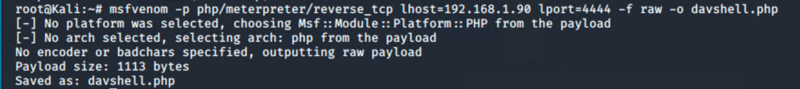
Exploitation: PHP Meterpreter Reverse Shell Payload
Tools & Processes
Metasploit was used to search php/meterpreter payloads.
A script was written and delivered via MSFVenom to establish a php reverse shell.
Achievements
Was successful using Metasploit to find a PHP Meterpreter payload.
php/meterpreter/reverse_tcp
Payload was successfully delivered using MSFVenom.
Successfully established a meterpreter session in target machine.
01
02
03
Tamantha Boychuk April 2022 Clickable Hyperlinks Highlighted & Underlined In Blue

Slide 11
Vulnerability Assessment
The assessment uncovered the following critical vulnerabilities in the target:
Vulnerability | Description | Impact
CVE-2020-14494 / CWE-307 | Authentication mechanism in the system does not provide sufficient complexity to protect against brute force attacks. | Can result in an attacker being able to discover multiple username/password combinations to gain access sensitive data on a system.
CVE-2017-7269 PROPFIND Request Exploit through WEBDAV service. | Bounds of the memory buffer are handled improperly making it possible for attacker to gain user rights. | This zero day exploit can result in catastrophic failure of confidentiality, integrity and availability of a system.
PHP Meterpreter Reverse_TCP Vulnerability CVE-2019-13386 (References reverse shell access with user privilege.) | This is a reverse shell payload used to gain meterpreter access to a compromised system through remote file injection. (RFI). | The severity of RFI attack can range from outputting the contents of a file to arbitrary code execution. In this case it allowed remote access in root to the affected server.
Tamantha Boychuk April 2022 Clickable Hyperlinks Highlighted & Underlined In Blue

Slide 12

Blue Team
Log Analysis and Attack Characterization
‹#›

Slide 13
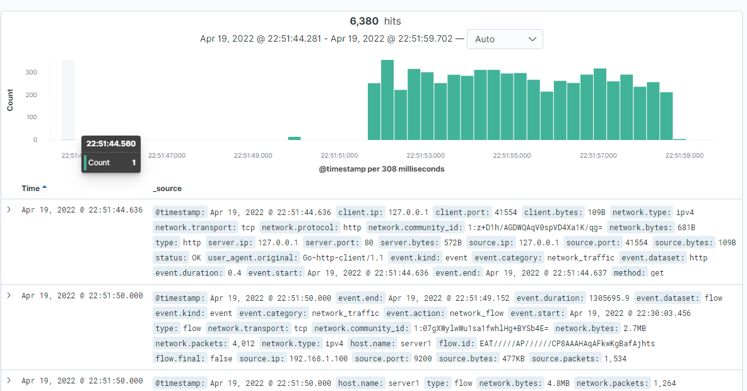
Analysis: Identifying the Port Scan
[Insert Here]
Include a screenshot of Kibana logs depicting the port scan.
Tamantha Boychuk April 2022
Notes:
What time did the port scan occur? April 19, 2022 @ 22:51:51
How many packets were sent, and from which IP? Packets were sent from Source IP 192.168.1.90 (Attacker Machine)
What indicates that this was a port scan? A increase in port scans all at one time indicates it was a port scan.

Slide 14
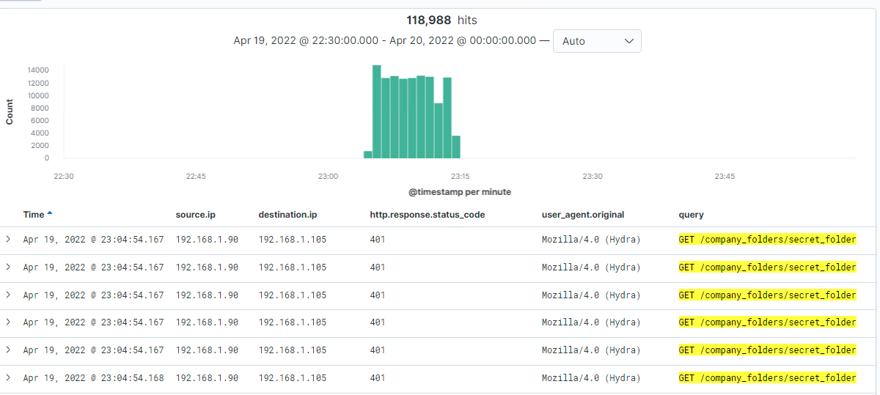
Analysis: Finding the Request for the Hidden Directory
[Insert Here]
Include a screenshot of Kibana logs depicting the request for the hidden directory.
Tamantha Boychuk April 2022
Notes:
What time did the request occur? 118,988 packets were sent.
Which files were requested? /company_folders/secret_folder
What did they contain? In company secret folder contained information on how to access the WebDAV connection as well as a hash for Ryan’s password.

Slide 15
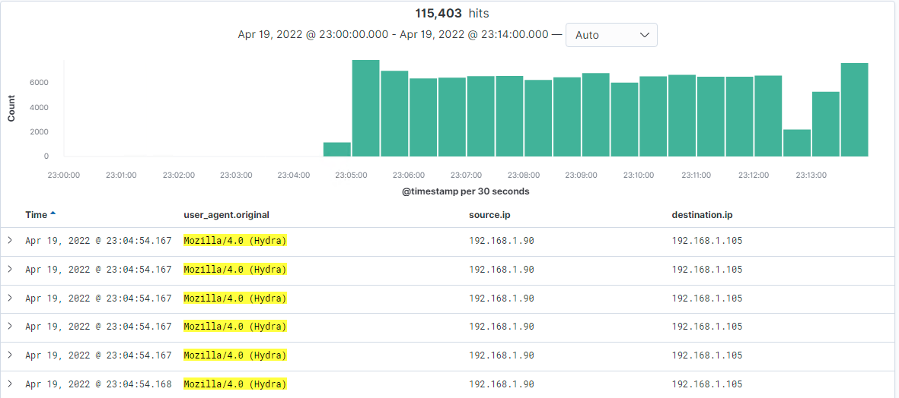
Analysis: Uncovering the Brute Force Attack
[Insert Here]
Include a screenshot of Kibana logs depicting the brute force attack.
Tamantha Boychuk April 2022
Notes:
How many requests were made in the attack? 115,403 request were made during brute force for passwords between 23:04:00 and 23:13:00.
How many requests had been made before the attacker discovered the password? Approximately 1150 request were made before the attack was obvious.

Slide 16
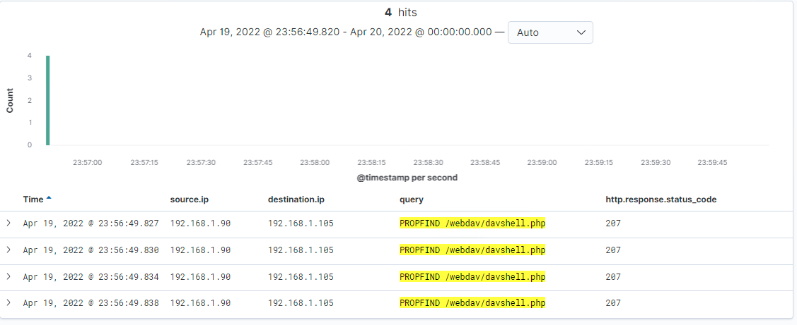
Analysis: Finding the WebDAV Connection
[Insert Here]
Add a screenshot of Kibana logs depicting the WebDAV connection.
Tamantha Boychuk April 2022
Notes:
How many requests were made to this directory? There were 4 request made to the directory.
Which files were requested? The davshell.php file was requested for the connection.

Slide 17

Blue Team
Proposed Alarms and Mitigation Strategies
‹#›

Slide 18
Mitigation: Blocking the Port Scan
The following alarm can be set to detect future port scans:
Search criteria: destination.ip: 192.168.1.105 and source.ip: (not 192.168.1.105) and destination.port: (not 443 or 80)
Report criteria: Number of ports accessed per source IP per second.
Alarm criteria/threshold: Alert email and log when > 2 none port 403 or port 80 scans detected at the same timestamp from the same IP occur.
Mitigation Strategy Recommendations:
First recommendation would be to use a more secure protocol such as HTTPS
Close ports 80 and 22 if possible.
Use Firewalls to redirect open ports to “honeypots” or to an empty host.
Utilize TCP wrappers to permit or deny access to the servers based on IP addresses or domain names.
Tamantha Boychuk April 2022

Slide 19
Mitigation: Finding the Request for the Hidden Directory
The following alarms can be set to detect future unauthorized access:
Any search from source.ip not 192.168.1.105 or 192.168.1.1 for *secret_folder*
Report criteria for any number of times the *secret_folder* has been accessed from external IP addresses.
Alarm threshold should be anything > ZERO access is detected on *secret_folder* from IP’s other than 192.168.1.105 or 192.168.1.1
Require stricter password policies for employees, especially those with hidden directory access.
Make directory listings not viewable on public facing website.
Again, update protocol from HTTP to HTTPS
Modifying configuration file for httpd:
Create backup first and then nano the httpd.conf file and and change the /var/www/ to order allow,deny the path of hidden directory and specify the IP addresses to allow.
Allow from 192.168.1.1
Allow from 192.168.1.105
Allow from 127
Deny 192.168.1.90
Tamantha Boychuk April 2022

Slide 20
Mitigation: Preventing Brute Force Attacks
Search criteria: http.request.method : "get" and user_agent.original :"Mozilla/4.0 (Hydra)" and url.path :"/company_folders/secret_folder/" and status :(Error or OK)
Report criteria: Number of times error code 401 response detected in 15 second interval.
Alarm criteria/threshold: Alert email and log when, on protected files and folders, > 5 Error (401) responses occur at any time OR any OK (200) responses occur from non-trusted IPs
Again, stronger password policies to include multi-factor authentication.
Lock out for 10 minutes after 3 failed login attempts
Use CAPTCHA to ensure user is human and not a bot.
Tamantha Boychuk April 2022

Slide 21
Mitigation: Detecting the WebDAV Connection
Search criteria: http.request.method : * and url.path: *webdav* and source.ip: (not 192.168.1.150 or 192.168.1.1)
Report criteria: Number of times the directory is requested from non-trusted IPs.
Alarm criteria/threshold: Alert email and log when requests are made, on protected files and folders, from non-trusted IPs
Modify your configuration file on the host to block unwanted access to the “webdav” from any IP other than those listed:
Open your httpd.conf file: > nano /etc/httpd/conf/httpd.conf Locate directory section (/var/www/) and set it as follows:
Order allow,deny Allow from 192.168.1.1 Allow from 192.168.1.105 Allow from 127 Deny from all
Source
Tamantha Boychuk April 2022

Slide 22
Mitigation: Identifying Reverse Shell Uploads
Search criteria: http.request.method : “put” and url.path: *webdav* and source.ip: (not 192.168.1.1 or 192.168.1.105)
Report criteria: Count directory “put” method from non-trusted IPs.
Alarm criteria/threshold: Alert email and log when “put” request methods are made, on protected folders, from non-trusted IPs
Require authentication to upload files
Store files in a directory not accessible by the public.
Make files only accessible from an application and not through the web server.
Tamantha Boychuk April 2022

